Slide 1
Software AIPEX PRO
Commissioning, Parameterization and Programming Software

Slide 2
Software AIPEX PRO
Commissioning and Parameterization Software

Slide 3
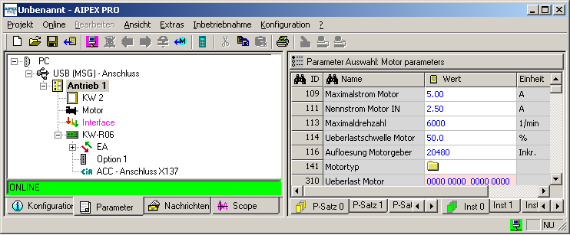
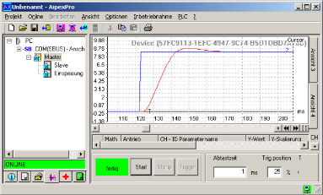
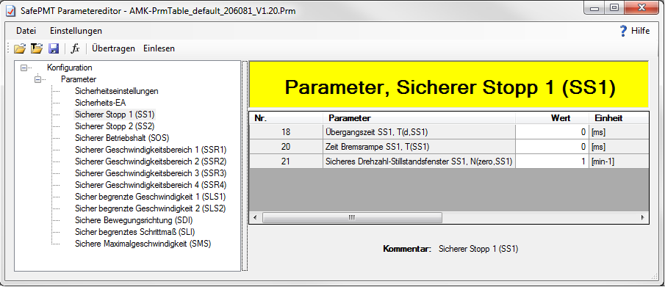
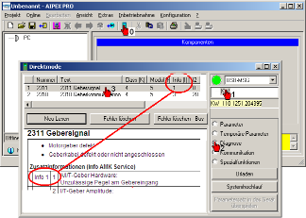


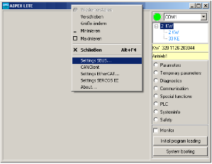
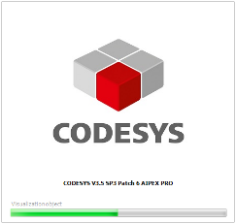

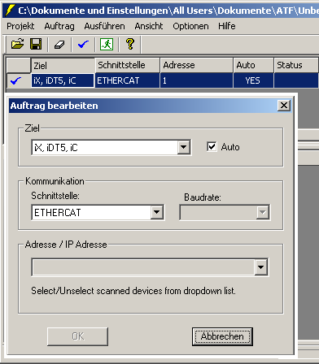
AIPEX PRO Program Overview
Device configuration
Parametrization
Commissioning support
Diagnostic
Safety Editor (sep. Tool)
All in ONE
Engineering Tool
AIPEX Lite (sep. Tool)
Controller programming CODESYS V2 and V3
Firmware-Flasher (sep. Tool)

Slide 4
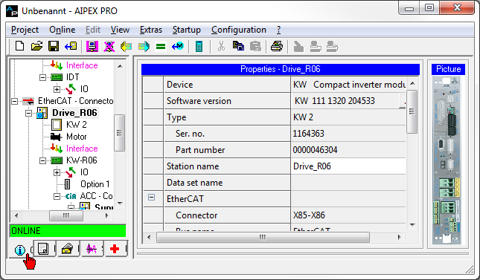
Configuration
Display and configuration of device-specific features.

Slide 5
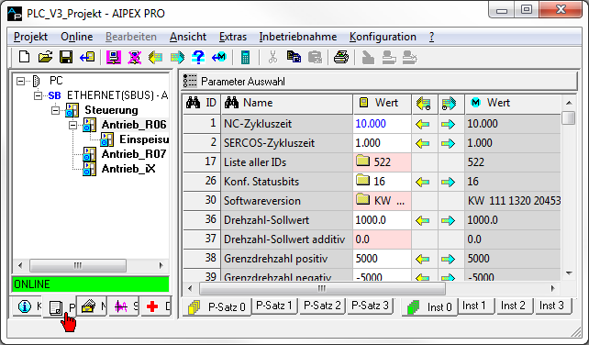
Parameter
Display and configuration of parameter values

Slide 6
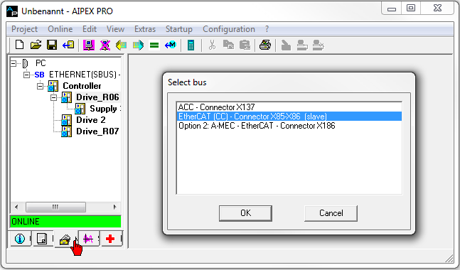
Messages
Display of the fieldbus configuration between the controller and the fieldbus device
Automatic fieldbus configuration by AIPEX PRO
Manual fieldbus configuration by the user

Slide 7
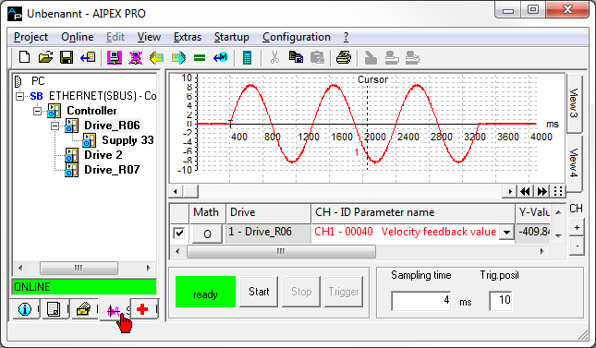
Scope
Every AMK drive has an internal oscilloscope function.
Configuration and display of the measurement signals by AIPEX PRO.

Slide 8
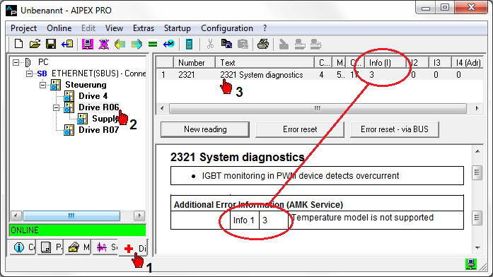
Diagnostic
Display of device-specific diagnostic messages

Slide 9
AIPEX PRO Program Overview
Function cannot
be used for
Formula Student
Device configuration
Parametrization
Commissioning support
Diagnostic
Safety Editor (sep. Tool)
All in ONE
Engineering Tool
AIPEX Lite (sep. Tool)
Function cannot
be used for
Formula Student
Controller programming
Firmware-Flasher (sep. Tool)

Slide 10
Configuration
Display and configuration of device-specific features.

Slide 11
Parameter
Display and configuration of parameter values

Slide 12
Messages
Display of the fieldbus configuration between the controller and the fieldbus device
Automatic fieldbus configuration by AIPEX PRO
Manual fieldbus configuration by the user
Function cannot
be used for
Formula Student

Slide 13
Scope
Every AMK drive has an internal oscilloscope function.
Configuration and display of the measurement signals by AIPEX PRO.

Slide 14
Diagnostic
Display of device-specific diagnostic messages

Slide 15


Usage

Slide 16
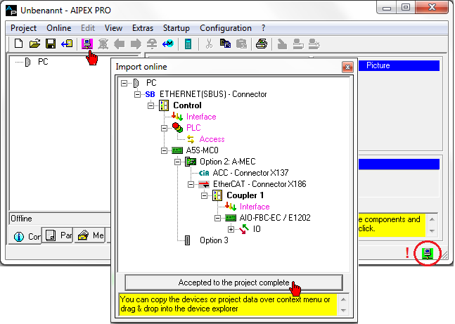
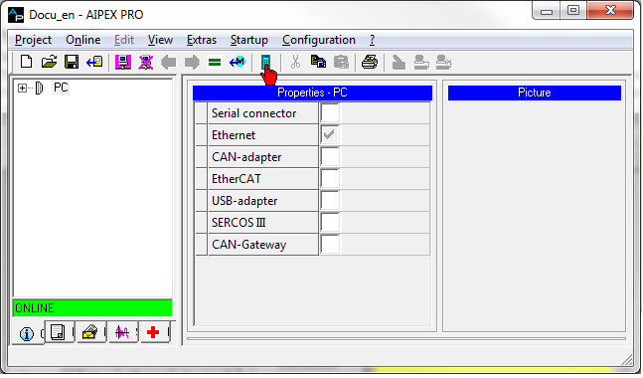
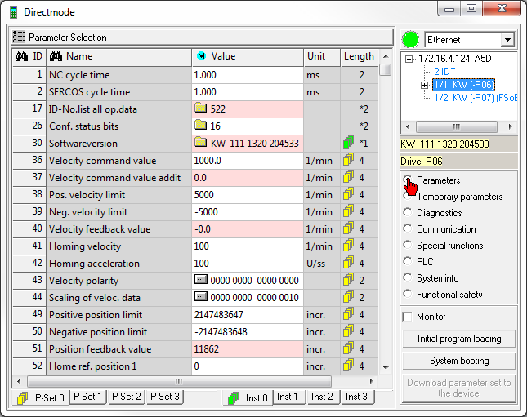
Display and Configure Device Values
Variant 1: Log in and create a project:
AIPEX PRO project is created
and can be saved on the PC.
Complete configuration option
Variant 2: Direct mode:
Fast access to (online) device parameters, diagnostics and information.

Slide 17
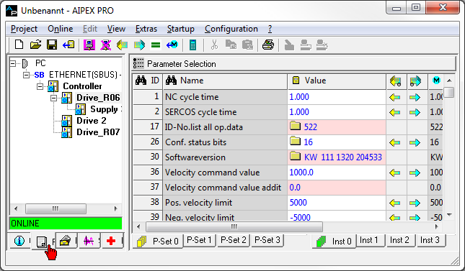


Status Information
Offline value (value saved in the PC (AIPEX PRO data project))
Online value (value stored in the device)
Device online reachable
Device online unreachable
Hardware status interface PC device
Status software interface PC device
Out of order
Ready for use

Slide 18
Parameter
Retentive parameters
Actual value when logging in (or refresh display F5)
Initial value when starting the device
Change takes effect, depending on the area of effect

Slide 19
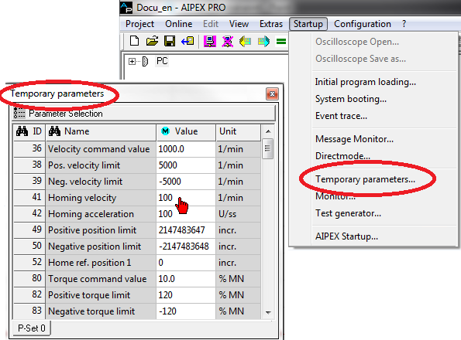
Temporary Parameters
Temporary parameters
Actual value when logging in (or refresh display F5)
Changes take effect immediately
Changes are discarded when switching off

Slide 20
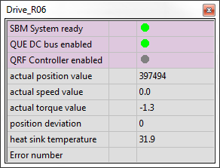
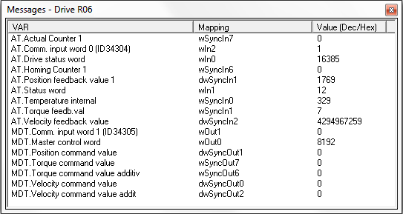
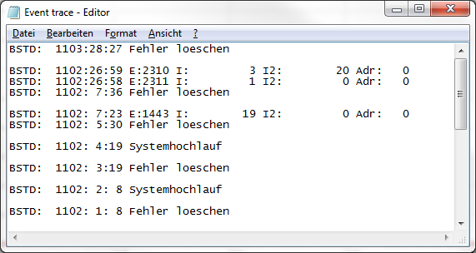
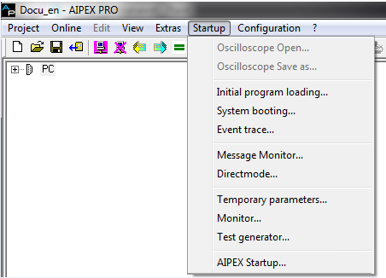
Display Options
Monitor
Message monitor
Event trace
Function cannot
be used for
Formula Student
Select drive
Start the display option in the <Startup> menu

Slide 21
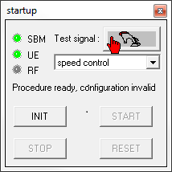
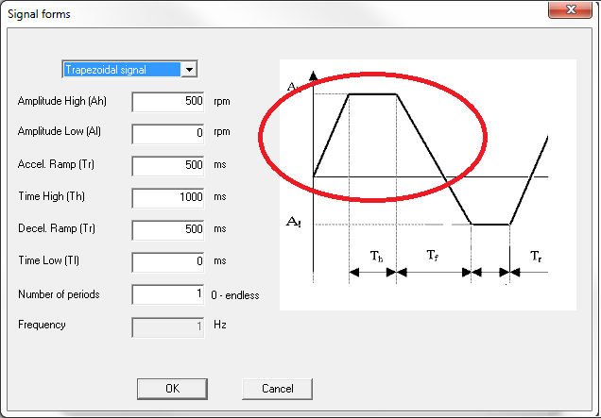
Test Generator
Application e. g. setpoint specification during commissioning.
The actual value can be recorded with the SCOPE.

Slide 22
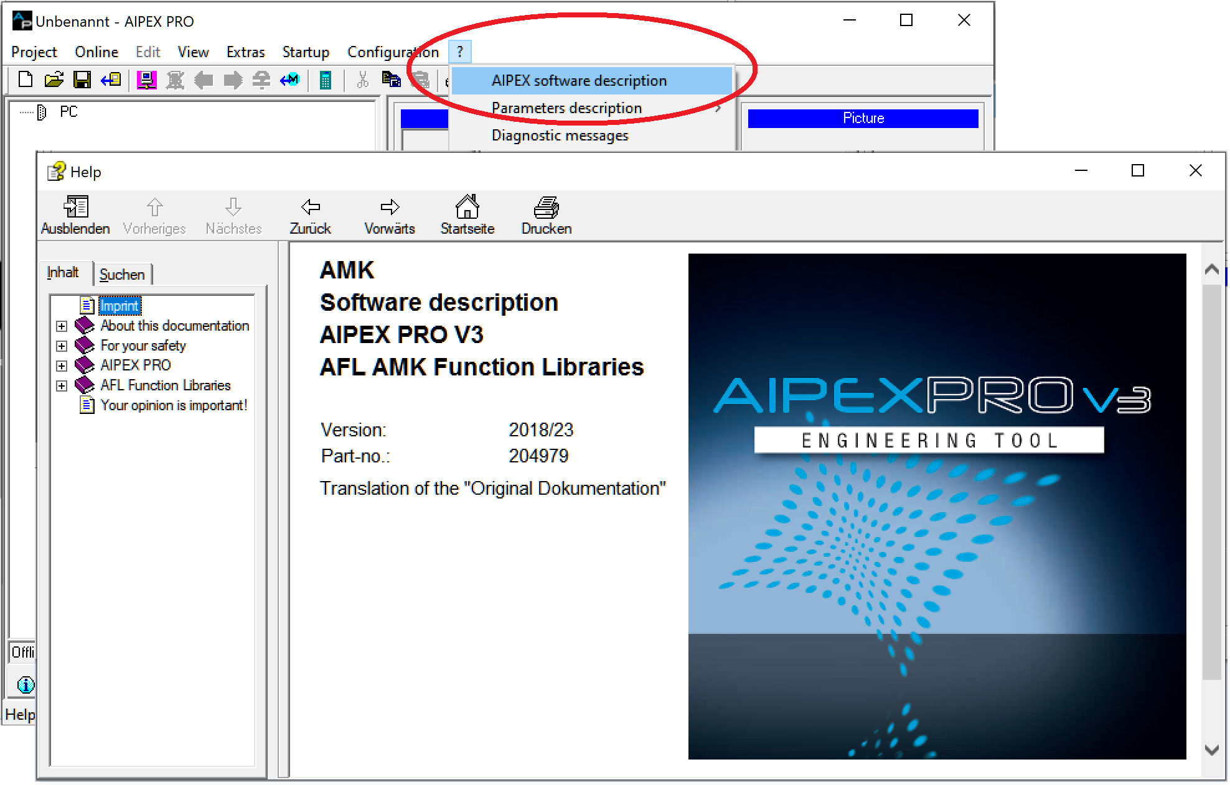
AIPEX PRO software description

